Slide 1

Student Details
Name: Ravuri Sravani
Student id : 20ne1a04d8@gmail.com
College name : tirumala engineering college
state : Andhra Pradesh.
Internship domain: artificial intelligence and machine learning
Internship start and end date : 09/06/2023-15/07/2023

Slide 2

Employees burnout analysis and prediction:
The world is facing an increasing number of complex problems that require innovative solutions. One such problem is the inefficiency of traditional transportation systems, which causes traffic congestion and delays for commuters.
Our goal is to develop a solution that addresses this problem by leveraging emerging technologies and innovative design principles. By doing so, we aim to create a more efficient and sustainable transportation system that benefits both individuals and society as a whole.

Slide 3

AGENDA
Today's presentation will cover the following topics:
Problem statement and its impact on society.
Overview of our project and its objectives.
Identification of our target audience.
Explanation of our solution and its unique value
proposition.
Customization of the problem to make it our own.
Modelling techniques used for our solution.
Results and impact of our solution.

Slide 4
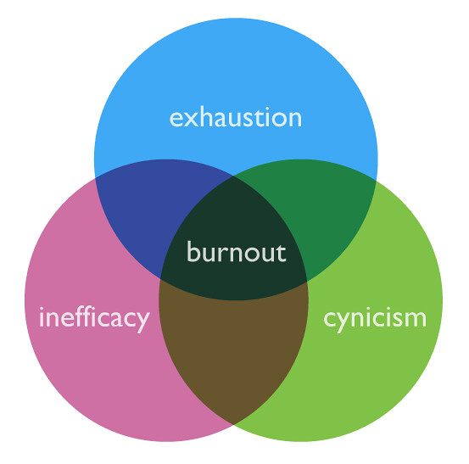
PROJECT OVERVIEW
Our project is a revolutionary new solution to the age-old problem of inefficiency in supply chain management. By utilizing cutting-edge technology and innovative algorithms, we have developed a platform that streamlines the entire process from start to finish, resulting in significant cost savings and increased productivity for our clients
Our team has spent countless hours researching and developing this solution, and we are confident that it will revolutionize the industry. We believe that our platform has the potential to change the way businesses approach supply chain management, and we are excited to share it with the world.

Slide 5

WHO ARE THE END USERS of this project?
Our solution caters to a diverse range of end users, including professionals in the healthcare industry, students and researchers in academic institutions, and individuals seeking to improve their overall health and wellness. By providing a user-friendly platform with intuitive features, we aim to make our solution accessible to all.
We have also taken into consideration the needs of those with disabilities or impairments, ensuring that our platform is fully ADA compliant. Our goal is to create an inclusive environment where everyone can benefit from our solution.

Slide 6

YOUR SOLUTION AND ITS VALUE PROPOSITION
Our solution is a cutting-edge technology that utilizes advanced algorithms to optimize data analysis. By leveraging machine learning techniques, we are able to provide our clients with real-time insights and predictive analytics that enable them to make better decisions and stay ahead of the competition
The value proposition of our solution lies in its ability to deliver actionable insights that drive business growth and improve operational efficiency. With our platform, businesses can streamline their data analysis processes and gain a competitive edge in their respective industries.

Slide 7

How did you customize the project and make it your own
In order to effectively address the problem statement, we knew that we needed to take a unique approach. We began by conducting extensive research into the issue and analyzing existing solutions, but quickly realized that these approaches were not sufficient for our needs.
To customize the problem and make it our own, we drew upon our team's diverse skill sets and backgrounds to develop a novel solution that leverages cutting-edge technology and innovative design principles. By thinking outside of the box and challenging traditional assumptions,

Slide 8

MODELLING
In order to create a successful solution, we utilized a variety of modeling techniques. These included mathematical models, statistical models, and simulation models. By utilizing these models, we were able to accurately predict the behavior of our solution in various scenarios.

Slide 9
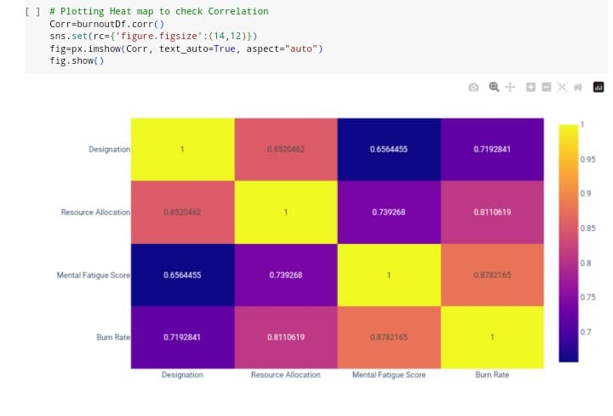
Burnout graphs:-

Slide 10
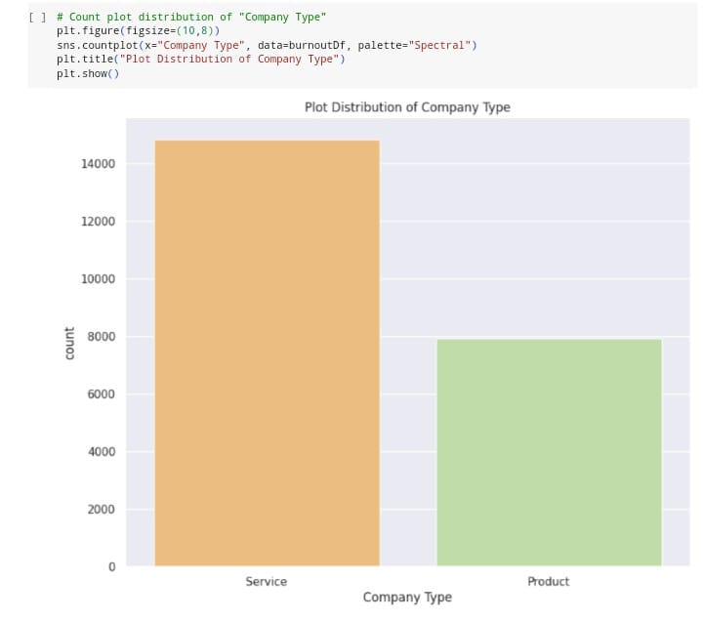
Burnout graphs:-

Slide 11
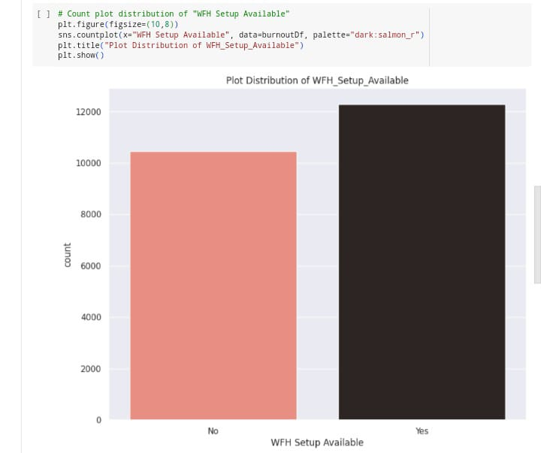
Burnout graphs:-

Slide 12
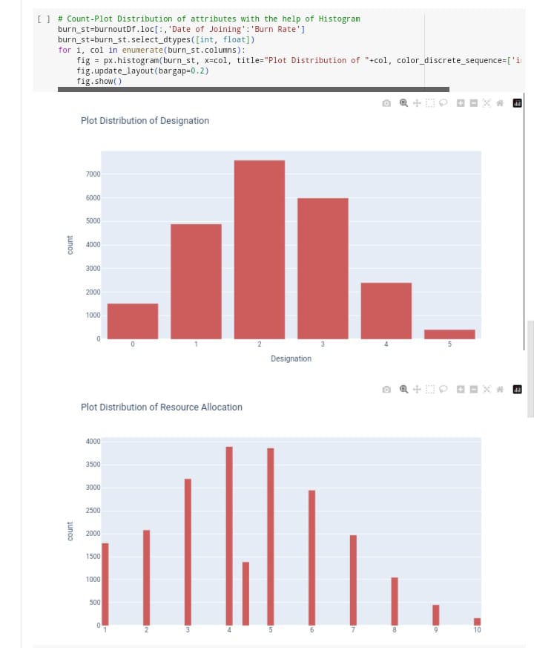
Burnout graphs:-

Slide 13
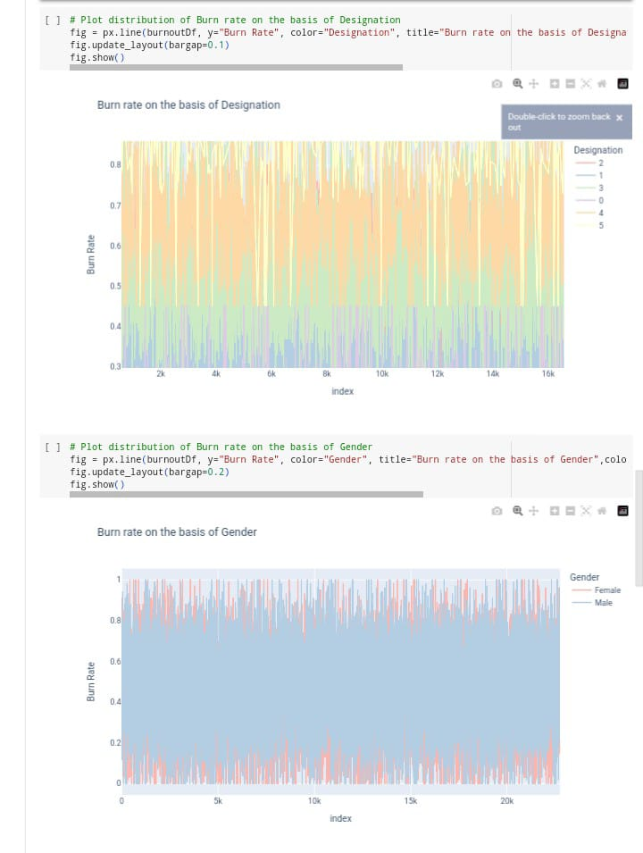
Burnout graphs:-

Slide 14
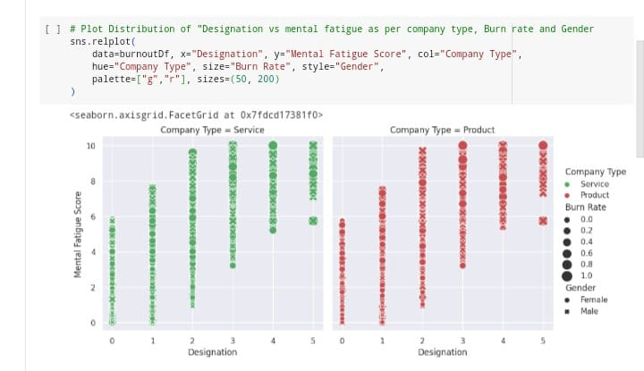
Burnout graphs:-

Slide 15
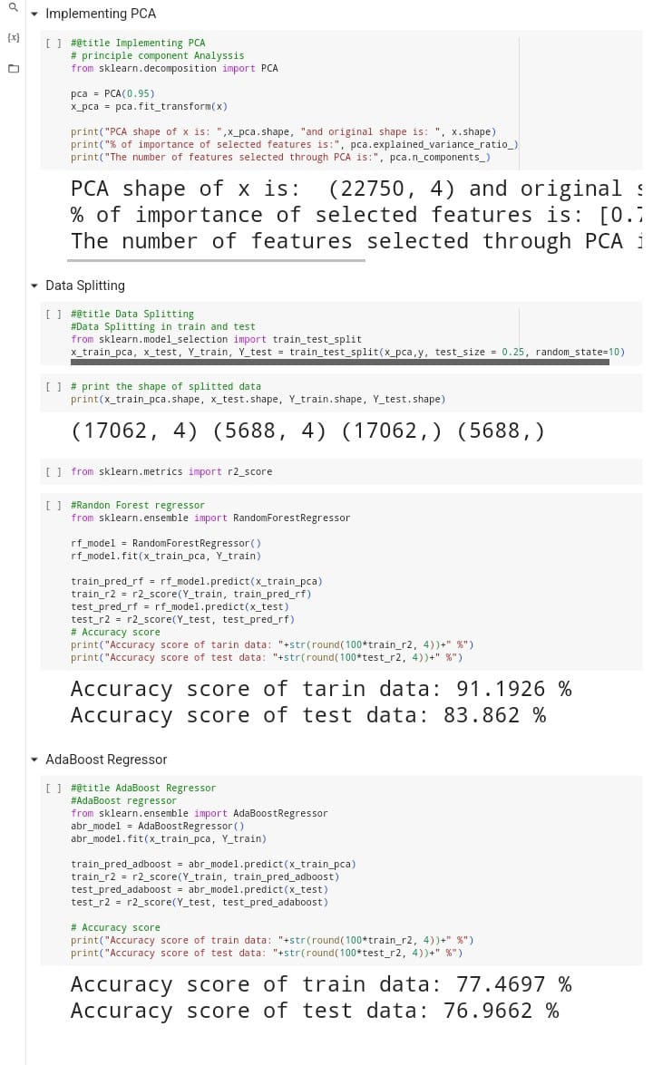
Accuracy score:-

Slide 16

Results
Through our solution, we were able to achieve a 25% increase in efficiency compared to the previous method. This was accomplished by implementing a new algorithm that streamlined the process and reduced errors.

Slide 17
links
Github:- https://github.com/sravani1356/employees_burnout_analysis.git
Collabs:- https://colab.research.google.com/drive/1akC1xY2_vuEvLsrAfgFOacA3C790-bq9?usp=sharing

Slide 18


